Slide 1
UPDATE ON OKLAHOMA REAL PROPERTY TITLE AUTHORITY:
STATUTES, CASES & TITLE EXAMINATION STANDARDS
REVISIONS FOR 2022-2023
(Covering July 1, 2022 to June 30, 2023)
BY:
KRAETTLI Q. EPPERSON, PLLC
NASH COHENOUR & GIESMANN
4104 PERIMETER CENTER DRIVE, SUITE 200
OKLAHOMA CITY, OKLAHOMA 73112
PHONE: (405) 917-5000
EMAIL: kqe@NashFirm.com
Webpage: www.EppersonLaw.com

Slide 2
Presented For the:
OBA REAL PROPERTY SECTION
2024 Cleverdon – Epperson Roundtable Seminar
At:
OKLAHOMA CITY, OK
(Thursday, May 16, 2024)
AND
TULSA, OK
(Friday, May 17, 2024)
2

Slide 3
TABLE OF CONTENTS
AUTHOR'S RESUME
I. STATUTORY CHANGES
II. CASE LAW
III. TITLE EXAMINATION STANDARDS CHANGES
APPENDICES
LIST OF LATEST 10 ARTICLES BY KRAETTLI Q. EPPERSON (Available Online @ EppersonLaw.com)

Slide 4
KRAETTLI Q. EPPERSON
ATTORNEY-AT-LAW
PROFESSIONAL:
NASH, COHENOUR, & GIESSMANN, P.C. -- Of Counsel
4101 Perimeter Center Drive, Suite 200, Oklahoma City, OK 73112
Voice: (405) 917-5000; E-mail: kqe@NashFirm.com; Website: www.EppersonLaw.com
Oklahoma Bar - Admitted 1979
Honors: AV rated; 2023 The Best Lawyers in America (Oil and Gas; Real Estate Law); 2023 Oklahoma Super Lawyers;
2023 405 Magazine Top Lawyers (Eminent Domain); 2023 Finance Monthly (Real Property); & 2023 Top 50 Lawyers in America
EDUCATION:
University of Oklahoma [B.A. (PoliSci-Urban Admin.) 1971];
State Univ. of N.Y. at Stony Brook [M.S. (Urban and Policy Sciences) 1974]; &
Oklahoma City University [J.D. (Law) 1978].
PRACTICE AREAS:
Mineral/Surface Title Matters: Trial/Appellate Briefs and Expert Consultant/Witness
Mediations and Arbitrations
Neighborhood Associations, and Restrictions
SAMPLE SUCCESSFUL APPELLATE CASES AND SAMPLE ENGAGEMENTS:
Appellant Counsel: Inadequate Legal Description (Riverbend Lands, LLC v. State of Oklahoma, ex rel, Oklahoma Turnpike Authority, 2019 OK CIV APP 31)
Amicus Brief: Enforcement of Ancient Probate (Bebout v. Ewell, 2017 OK 22)
Secured AG Opinion: Safe Distance Between Residences and Well Sites (2009 OK AG 5)
Court-Appointed Receiver for 5 Abstract Companies
SPECIAL ACTIVITIES:
OBA Title Examination Standards Committee (Chairperson: 1988-2020; Member: 1980-present)
Oklahoma City University School of Law adjunct professor: “Oklahoma Land Titles” (1982-2018)
Vernons 2d: Oklahoma Real Estate Forms and Practice, (2000 - Present) General Editor and Contributing Author
SELECTED PUBLICATIONS:
“Residential Restrictive Covenants: The Amendment Process Under 11 O.S. Section 42-106.1”, 94 OBJ 40 (September 2023)
“Probate ‘Venue’ Is, and Always Has Been, ‘Jurisdictional’: Legislative Confirmation of ‘Fulks’”, 94 OBJ 40 (August 2023)
“Payment of Proceeds from Production Under the PRSA: The Obligation to Determine Current ‘Marketable Title’” 93 OBJ 5 (May 2022)

Slide 5
Passed 2023 Legislation Impacting Oklahoma Title and Real Property Attorneys September 20, 2023
By Tyler K. Larsen
Deadline | Deadline Date
Deadline for Filing of Bills and Joint Resolutions | January 17, 2023 at 4pm
First Day of the First Regular Session of the 59th Legislature | Monday, February 06, 2023
Deadline for HBs/HJRs out of Subcommittee | Monday, February 27, 2023
Deadline for HBs/HJRs out of Standing Committee | Thursday, March 02, 2023
Deadline for Third Reading of Bills and Joint Resolutions in Chamber of Origin | Monday, April 03, 2023
Deadline for SBs/SJRs out of Subcommittee | Friday, April 07, 2023
Deadline for SBs/SJRs out of Standing Committee (exception for SBs/SJRs in full A&B Committee | Thursday, April 17, 2023
Deadline for SBs/SJRs out of full A&B Committee | Friday, April 14, 2023
Sine Die Adjournment | May 26, 2023

Slide 6
Bill No.: SB 212
Brief Title: Property; prohibiting certain ownership of land through business entity or trust; requiring affidavit with recording deed.
Sponsor: Bullard (Senate); Burns (Senate); Humphrey (House); Stephens (Senate); Jett (Senate)
Description: Amends 60 O.S. 2021, §121 and §125

Slide 7
Cont’d…Bill No.: SB 212
Status: First Reading 2/6/23; Authored by Bullard 2/6/23; Second Reading referred to Judiciary 2/7/23; Withdrawn from Judiciary Committee 2/7/23; Referred to Judiciary Committee then to Appropriations Committee 2/7/23; Co-authored by Representative Humphrey 2/9/23; Reported Do Pass 11-1 as amended Judiciary committee; Referred to Appropriations 2/14/23; Passed Judiciary Committee 11-1 vote, 2/14/23; Title Stricken 2/14/23; Referred to Appropriation 2/20/23; Passed 3/8/23; Referred for engrossment 3/8/23; Engrossed to House 3/9/23; First Reading 3/9/23; Passed Business and Commerce Committee 4/5/2023; referred to engrossment 4/26/2023; Engrossed 4/27/2023; Passed 5/22/2023 Approved 6/6/2023.

Slide 8
Cont’d Bill No. SB 212
Comment: SB 212 requires an affidavit regarding ownership be attached to deeds. Attorney General is responsible for promulgating the form. Establishes a Citizen Land Ownership Unit to enforce the provisions of the act.

Slide 9
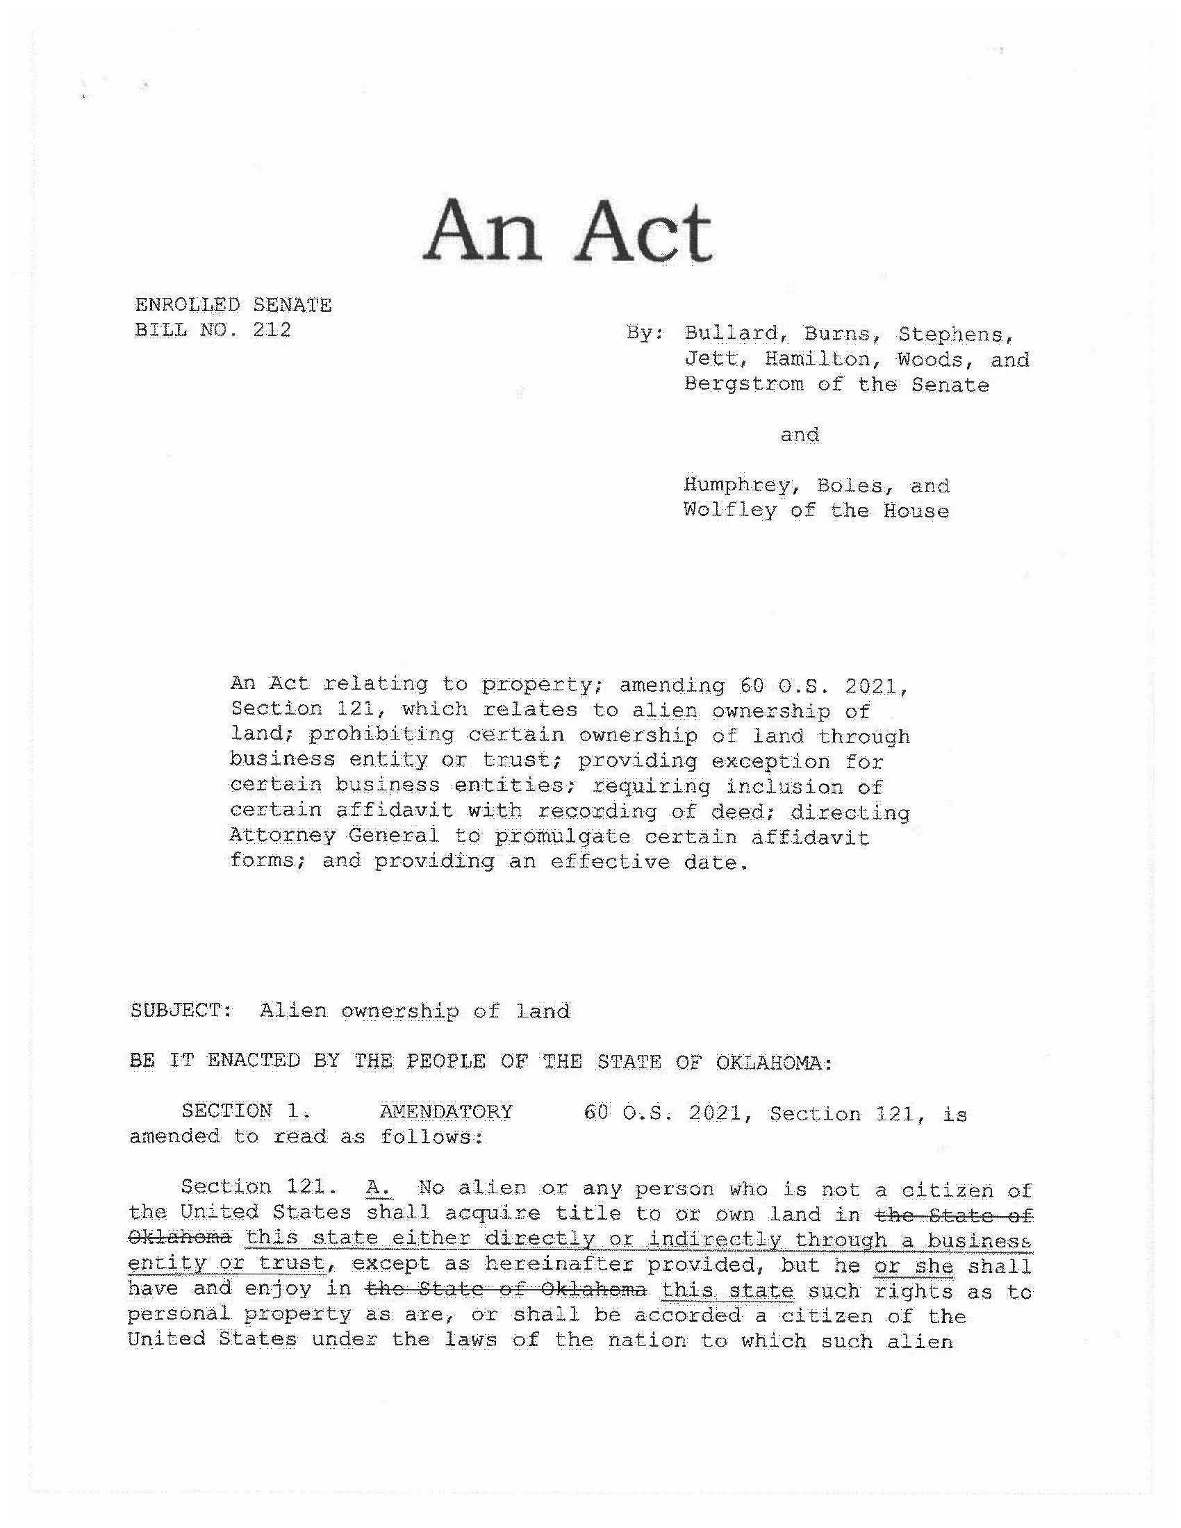

Slide 10
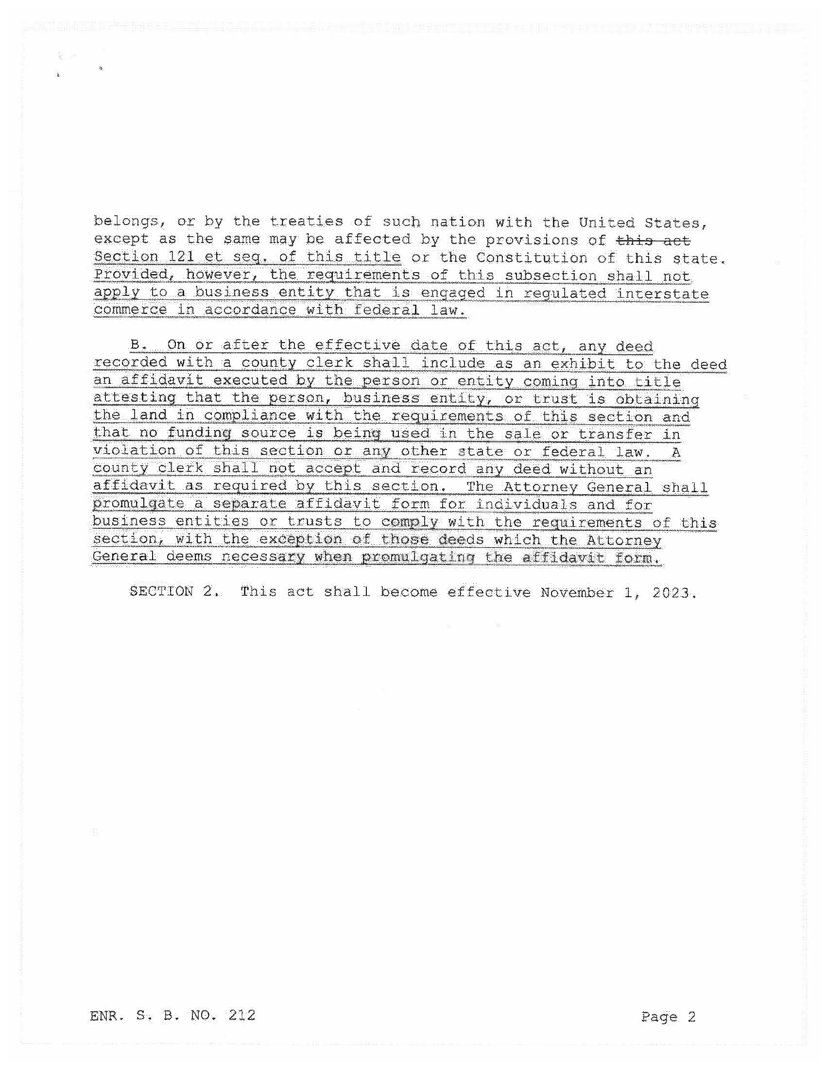

Slide 11
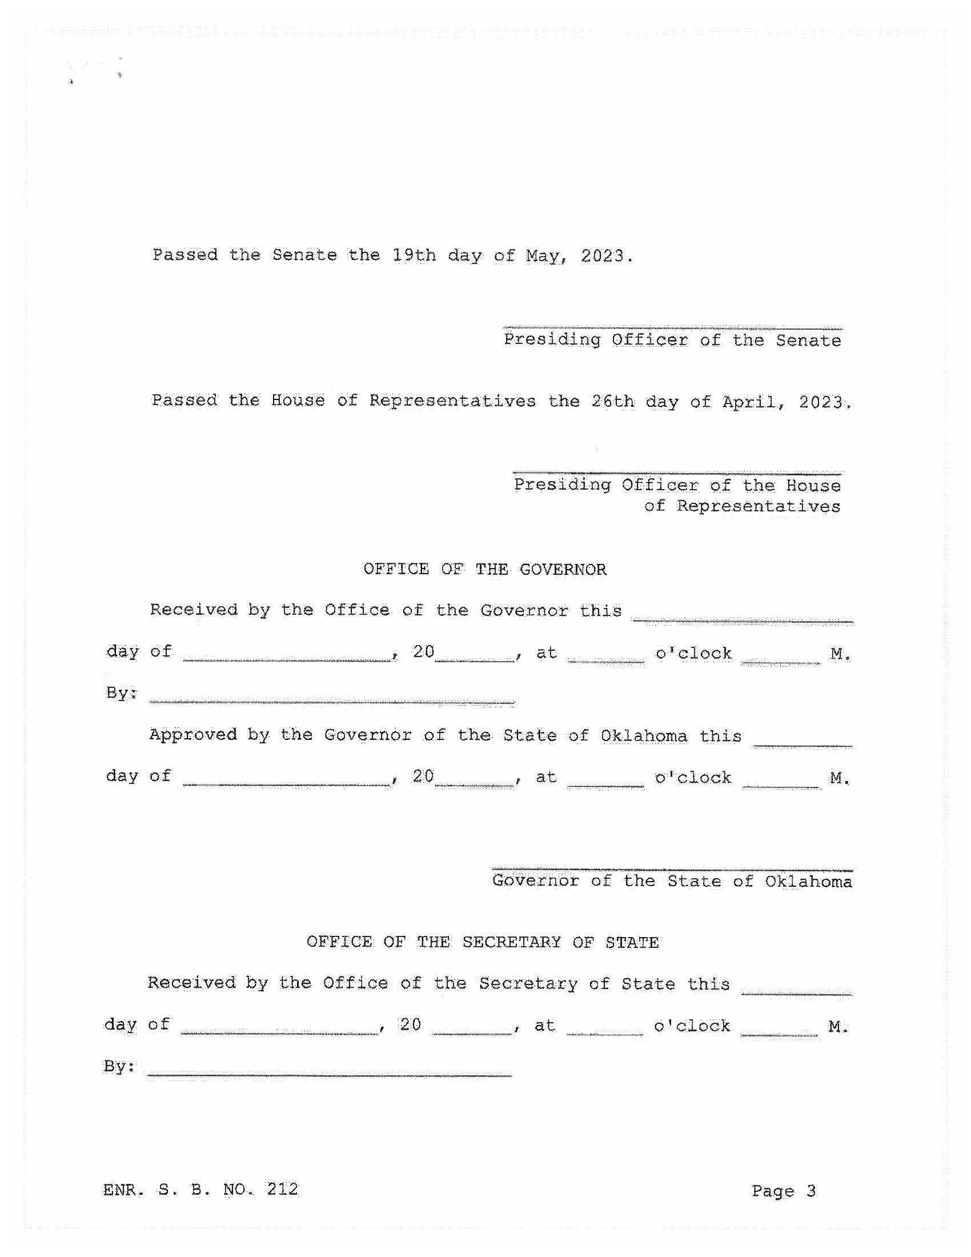

Slide 12
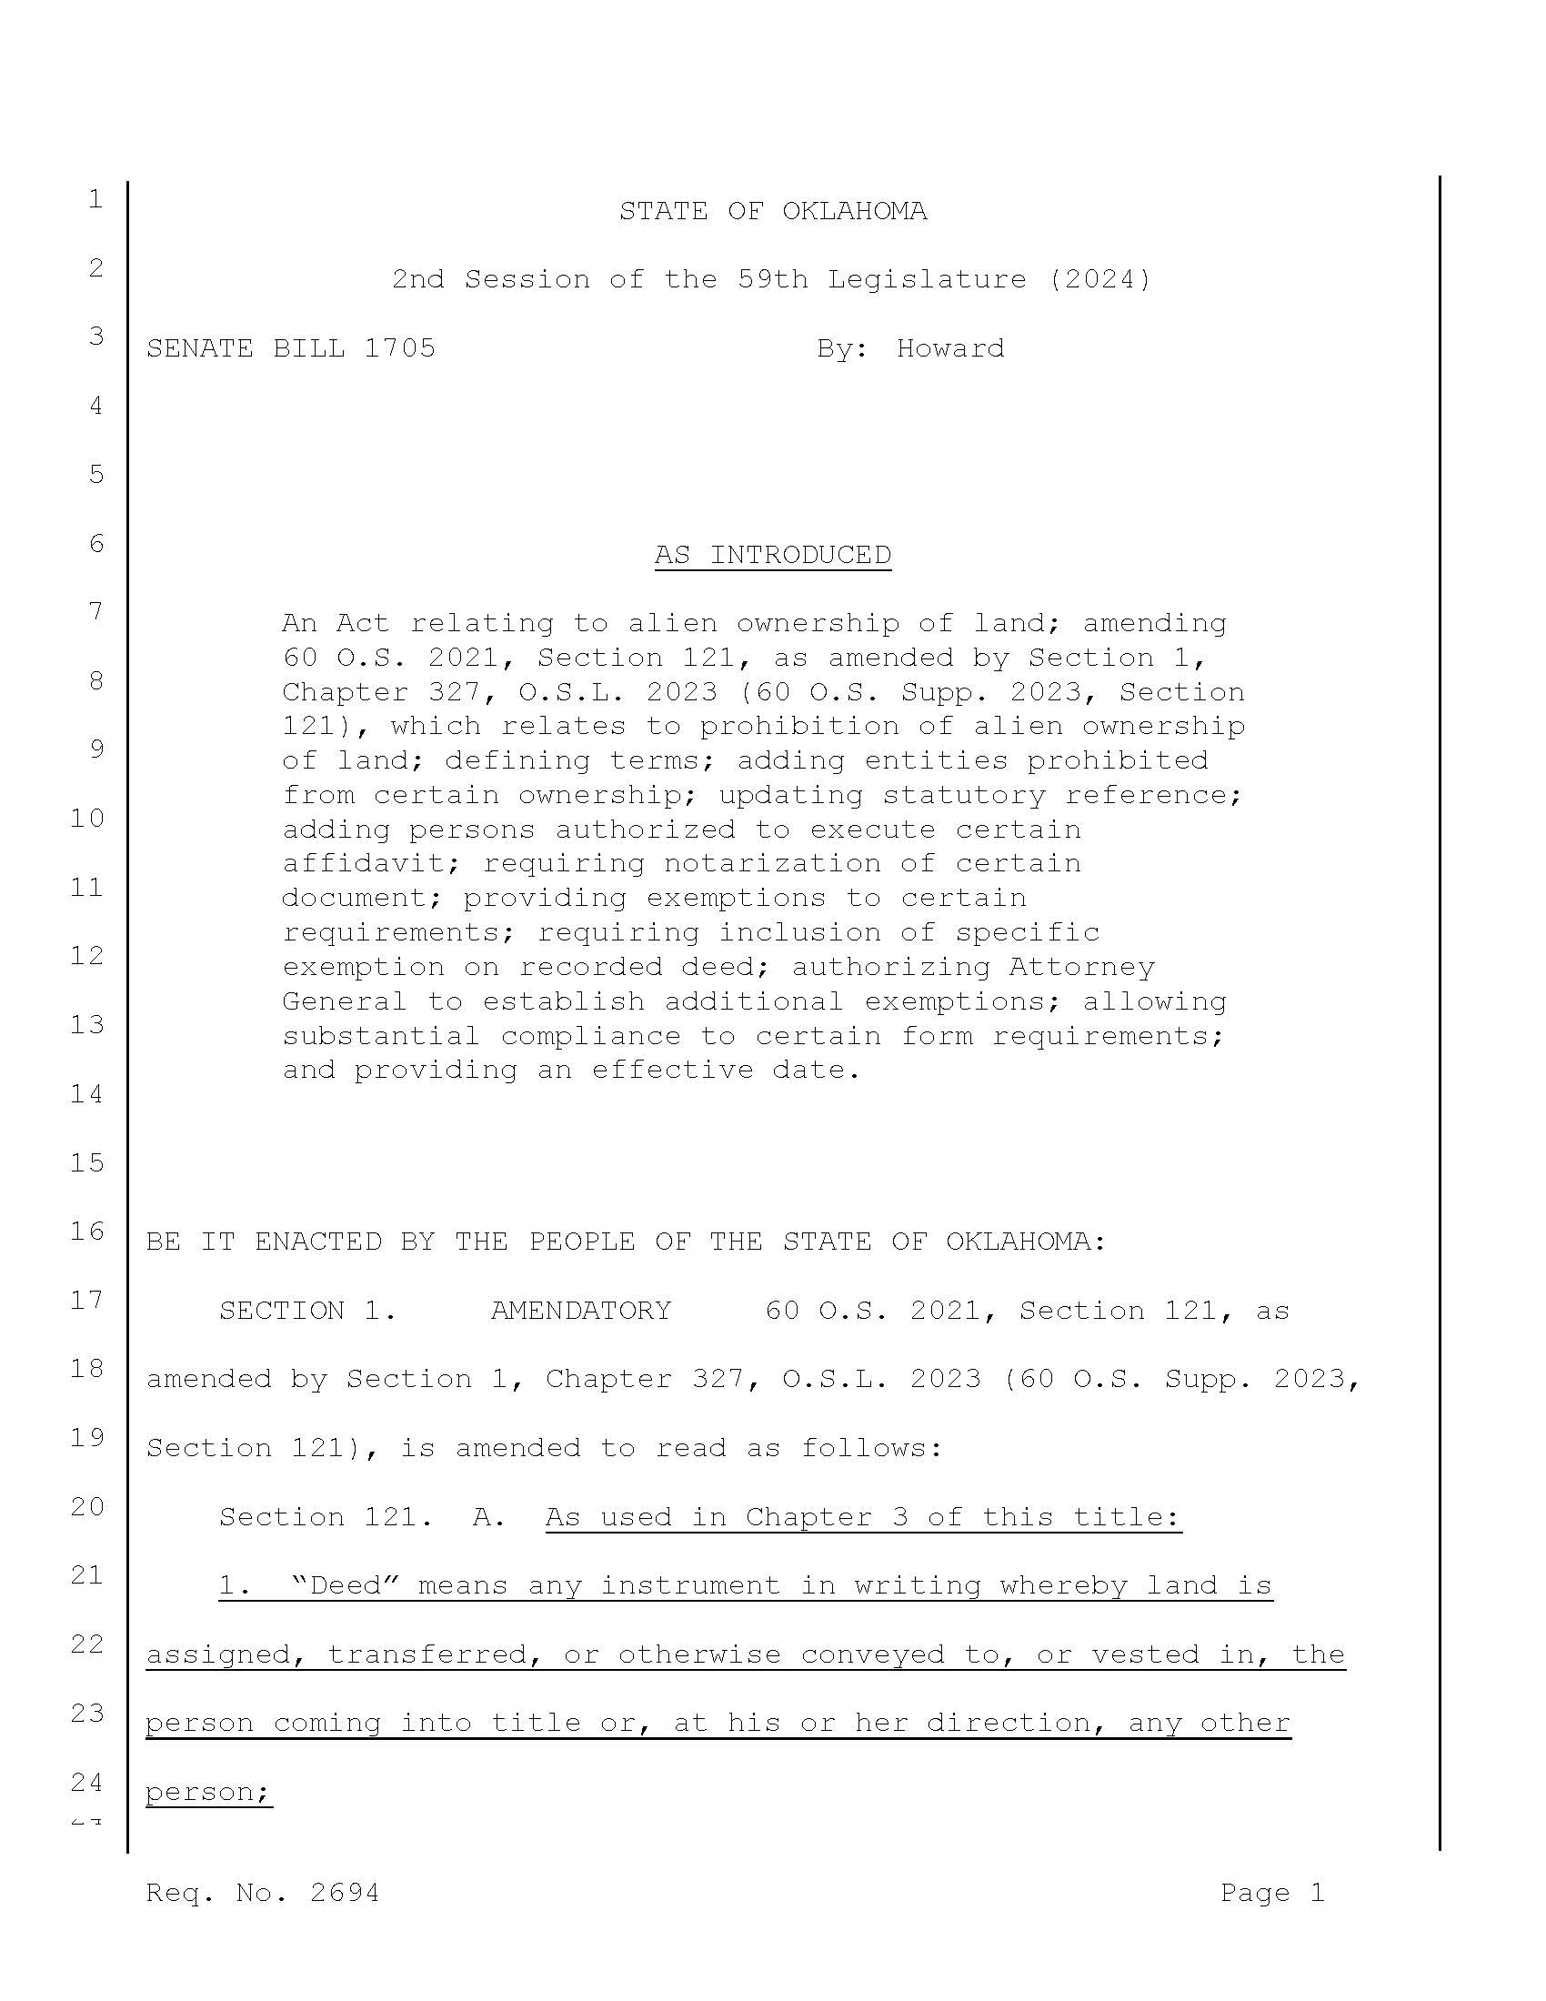

Slide 13
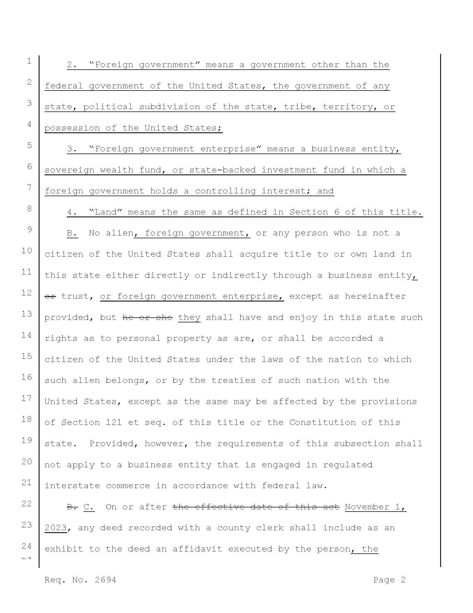

Slide 14
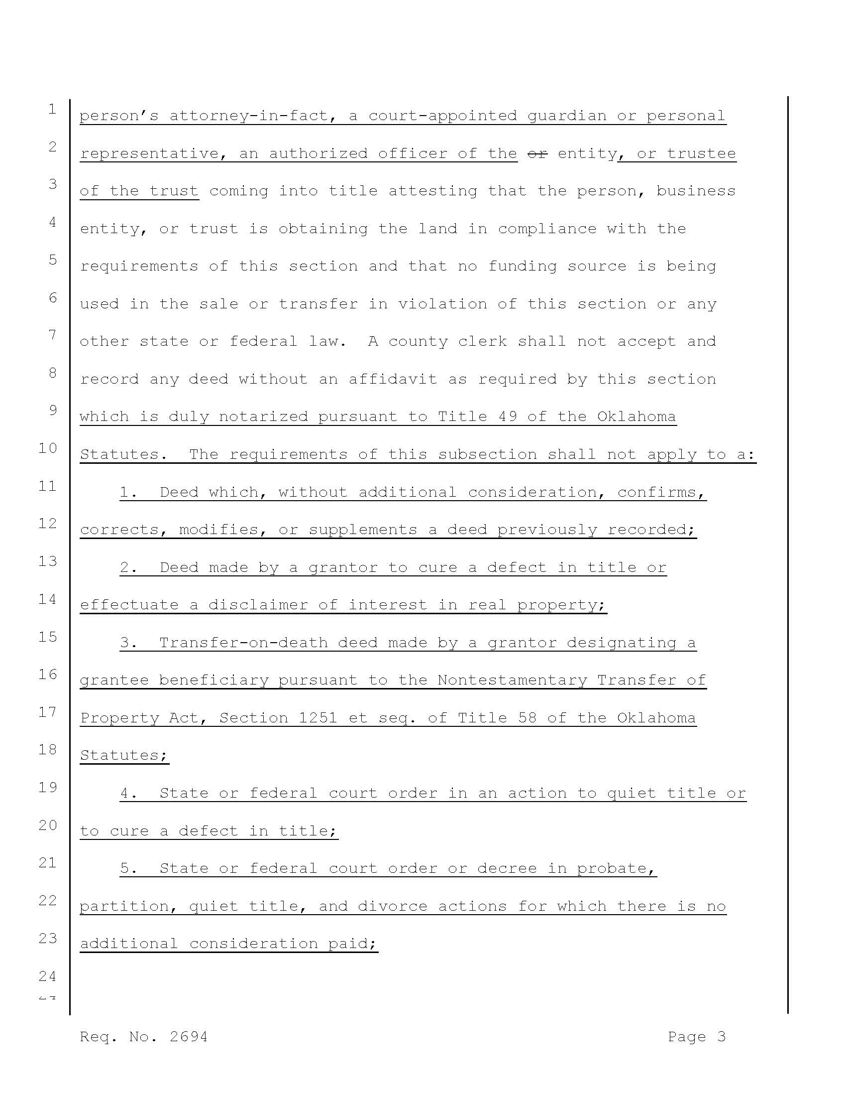

Slide 15
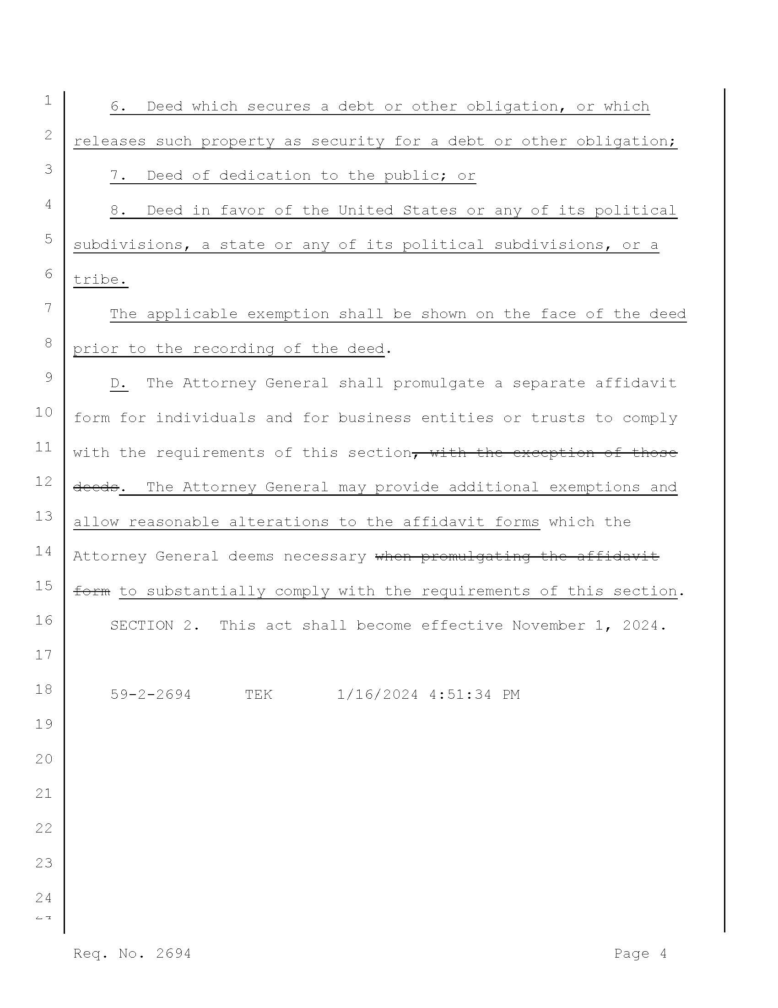

Slide 16
Bill No.: SB 298
Brief Title: Transfer-on-death Deeds; clarifying ability of grantee beneficiary to accept certain property.
Sponsor: Howard (Senate); Moore (House)
Description: Amends 58 O.S. 2021, §1252
Status: First Reading 2/6/23; Authored by Howard 2/6/23; Second Reading referred to Judiciary 2/7/23; Reported Do Pass Judiciary Committee 10-0 2/7/23; Co-author 2/20/23; Measured Passed 3/2/23; Referred for Engrossment 3/2/23; First Reading 3/6/23; Sent to Governor 4/20/2023; Approved by Governor 4/26/23
Comment: SB298, by Sen. Brent Howard, R-Altus, only allows designated grantee beneficiaries to accept real estate in a transfer-on-death on behalf of themselves or a legal entity over which they have a proper authority, and sets that one or more, but not all named beneficiaries of a transfer-on-death deed must explicitly accept the interests being conveyed by the deed on behalf of all or some of the named beneficiaries. Bill has been signed into law.

Slide 17
Bill No.: HB 2288
Brief Title: Conveyances; discriminatory restrictions; prohibitions; civil procedure; action to remove discriminatory restrictions; Effective date.
Sponsor: Pfeiffer (House) Howard (Senator)
Description: An act relating to conveyances; defining discriminatory restriction; prohibiting discriminatory restrictions in real estate transactions; providing discriminatory restrictions are unenforceable; providing that a court, upon petition, may order the removal of discriminatory provisions from recorded conveyances or instruments; providing for codification.
Status: First Reading 2/6/23; Authored by McCall 2/6/23; Second Reading referred to Rules 2/7/23; Pass by committee 3/6/23; Co-Authored by Rep Pae 3/6/23; Second Reading referred to Judiciary 3/30/23; Passed Judiciary Committee 4/4/23; House Floor Amendment 4/18/23; Sent to Governor for signing 5/17/2023.

Slide 18
Cont’d Bill No.: HB 2288
Comment: Creates a new section of law to be codified as 12 O.S. 1149. Provides for when an instrument contains a discriminatory provision and a court determines that the provision is discriminatory, the court shall issue an order declaring the provision to be null and void and shall order the office of the county clerk of the county in which the real property is located to remove the discriminatory provision from the recorded real estate transaction, conveyance or instrument.

Slide 19
OKLAHOMA SUPREME COURT CASES:
JULY 1, 2022 – JUNE 30, 2023

Slide 20
A. OKLAHOMA SUPREME COURT CASES
(JULY 1, 2022-JUNE 30, 2023)
LIST OF CASES
# | TOPIC |  | CASE | OLAHOMA CITATION | DECIDED
 |  |  |  |  | MANDATE
 | GENERAL | BRIEF HOLDING
A. OKLAHOMA SUPREME COURT
1 | Intangible Personal Property | Production Tax Credits Are Not Tangible Personal Property | Kingfisher Wind, LLC v. Matt Wehmuller, Canadian County Assessor & Carolyn Mulherin | 2022 OK 83 | 10/18/22
 |  |  |  |  | 1/25/23
2 | Mortgage Foreclosure as Malicious Prosecution | Vacation of Improper Foreclosure Constitutes Prevailing, Even if Also Dismissed | Cole v. Bank of America | 2022 OK 96 | 12/6/22
 |  |  |  |  | 1/5/23

Slide 21
A. OKLAHOMA SUPREME COURT CASES
(JULY 1, 2022-JUNE 30, 2023)
LIST OF CASES
# | TOPIC |  | CASE | OLAHOMA CITATION | DECIDED
 |  |  |  |  | MANDATE
 | GENERAL | BRIEF HOLDING
A. OKLAHOMA SUPREME COURT
3 | Divorce: Timeless of Appeal, AND Enforcement of Settlement Agreement | Appeal Time Runs From Record of Service, AND Settlement Agreement is Enforced Absent Fraud or Coercion | Owens v. Owens | 2023 OK 12 | 2/14/23
 |  |  |  |  | 6/8/23
4 | Pretermitted Heirs | Allocate Assets Among Heirs and Legatee | In the Matter of the Estate of Parker | 2023 OK 50 | 5/2/23
 |  |  |  |  | 6/1/23
5 | Mortgage Foreclosure | Installment Note Is Accelerated When Declared or Suit Filed, and Is Decelerated When Suit Dismissed | MTGLQ Investors v. Witherspoon | 2023 OK 62 | 6/6/23
 |  |  |  |  | 7/20/23

Slide 22
1. KINGFISHER WIND, LLC v. MATT WEHMULLER, CANADIAN COUNTY ASSESSOR & CAROLYN MULHERIN (2022 OK 83)
GENERAL TOPIC: Intangible Personal Property
SPECIFIC TOPIC: Production Tax Credits Are Not Intangible Personal Property

Slide 23
FACTS:
Canadian County and Kingfisher County Assessors included the “value” of the financing tool known as the Production Tax Credits (PTC) to assist in the construction of a wind farm including 149 wind turbines, and other equipment extending into two counties, both Canadian and Kingfisher Counties. The County assessors included such PTC’s as part of the valuation of the wind farms lands. The combined valuation for the two counties for the wind farm’s “fair cash value” totaled $458,003,507.00. The company, Kingfisher Wind, LLC, challenged the assessment in District Court.

Slide 24
TRIAL COURT DECISION:
The trial court “issued another memorandum opinion in which it determined that the PTCs are not really property of any kind -- intangible or tangible. Rather, it said PTCs are incidental benefits received by investors as a result of their participation in an investment made in the future production of the wind farm that should not be treated as property.” At a non-jury trial, the trial court again ruled the “the PTCs are not taxable.”

Slide 25
COURT OF CIVIL APPEAL DECISION:
The county assessors appealed and asked the Oklahoma Supreme Court to retain the “first impression” matter. The Oklahoma Supreme Court did retain the matter.

Slide 26
SUPREME COURT DECISION:
The Oklahoma Supreme Court reviewed the Okla. Const. Art. 10 Section 6A, which, before amendment: “listed only certain property items such as money, stocks, bonds, and certain credit accounts, to be defined as intangible property exempted from taxation;” Thereafter “the voters passed State Question 766 in November of 2012. It amended the Okla. Const., art. 10, §6A to omit the specific list of intangible personal property exempt from taxation and simply stated that:
Beginning January 1, 2013, intangible personal property shall not be subject to ad valorem tax or to any other tax in lieu of ad valorem tax within this State.”
“Given the rationale of Globe Life, supra, as well as the fact that the Constitution was changed after our decision in Southwestern Bell, supra, to exclude all intangible property from taxation, we must conclude that PTCs are to be treated as intangible property, even if they have qualities of both tangible and intangible property.” The trial court decision was affirmed.

Slide 27
2. COLE v. BANK OF AMERICA (2022 OK 96)
GENERAL TOPIC: Mortgage Foreclosure as Malicious Prosecution
SPECIFIC TOPIC: Vacation of Improper Foreclosure Constitutes Prevailing, Even If Also Dismissed

Slide 28
FACTS:
Couple were divorced, and wife got title to house along with the note and mortgage obligation. Both the husband and wife were on the note and mortgage. The wife and the bank, without the knowledge or consent of the husband, entered into a modification agreement changing the term of the note and mortgage. The wife defaulted on the note, and the bank initiated a mortgage foreclosure against only the husband, using the original note, with no disclosure of the modification agreement.

Slide 29
TRIAL COURT DECISION:
The trial court entered summary judgment against the husband on the initial note and mortgage. The alleged terms of the note and mortgage in the Petition did not match the initial note and mortgage. Husband “filed a motion to vacate judgment arguing that it was not supported by the Bank’s evidence and the terms recited in the judgment conflicted with the evidence.” Two weeks after this Motion to Vacate was filed, the bank disclosed the existence of the modification agreement, signed solely by the wife. One month after this Motion was filed, the bank filed a partial release of judgment as to the husband. Three months after the Motion was filed, the bank finally produced the modification agreement, and still fought the Motion to Vacate, claiming that “bank’s own failure to disclose this modified note was actually the fault of Cole [the husband] for failing to conduct discovery.” “The district court denied the motion to vacate. Cole appealed.”

Slide 30
COURT OF CIVIL APPEALS DECISION:
COCA “directed the trial court to grant Cole’s motion to vacate judgment.” This was because “Cole did not sign the modification.”
“[Defendant] after a favorable appellate ruling vacating judgment against him, filed this action including claims for malicious prosecution…”.

Slide 31
TRIAL COURT SECOND DECISION:
“On the same day that the trial court vacated judgment, [complying with the COCA opinion], Bank filed a dismissal without prejudice stating that ‘said defendant [husband] not being a necessary party herein.’” “Husband immediately filed an action against the Bank asserting malicious prosecution, seeking “compensatory damages to include attorney fees, time missed from work, damage to his credit score, and well as emotional distress and punitive damages.” The Bank filed a motion to dismiss the malicious prosecution action, asserting “because Bank filed a dismissal without prejudice as to Cole [leaving the case in place to add the wife and seek judgment against her], there had not been a favorable termination as to him.” The husband appealed. The trial court dismissed the malicious prosecution action. The husband appealed.

Slide 32
COURT OF CIVIL APPEALS SECOND DECISION:
COCA affirmed the trial court’s dismissal of the malicious prosecution action, holding “Bank’s ‘dismissal of the foreclosure action without prejudice was not a termination of that suit in Cole’s favor which will support his action for malicious prosecution.’”.

Slide 33
SUPREME COURT DECISION:
Cert was granted. The Oklahoma Supreme Court held that the husband succeeded on vacating the foreclosure judgment, and that the “foreclosure judgment against him was inherently defective”. Consequently, because the dismissal of the malicious prosecution action was based solely on a determination that the termination of the foreclosure was NOT a favorable termination for the husband, such dismissal was incorrect. The Supreme Court ruled “the case is remanded to the trial court for further consideration of the other elements of this cause of action [malicious prosecution] and for such other proceedings as are warranted.”

Slide 34
3. OWENS v. OWENS (2023 OK 12)
GENERAL TOPIC: Divorce: Timeliness of Appeal, AND Enforcement of Settlement Agreement
SPECIFIC TOPIC: Appeal Time Runs From Record of Service, AND Settlement Agreement Is Enforced Absent Fraud or Coercion

Slide 35
FACTS:
Parties filed for divorce. After mediation the parties signed a settlement agreement splitting their assets including both their prior house and their current house. Husband sought to embody such settlement agreement into a judgment. The wife received assets valued at $435,600, and the husband received assets worth $344,700. Wife refused to allow judgment to be issued based on such agreement, and sought to repudiate such agreement, in the trial court’s words: due to “a simple change of strategy.” Wife had brought a house and a bank account into the marriage. They moved and bought a new house in both of their names. The first house was eventually sold. The wife argued that the settlement agreement failed to give her sufficient credit for her separate marital property (land and bank account).

Slide 36
TRIAL COURT DECISION:
The trial court held extensive evidentiary hearings at which only the two spouses testified. The trial court issued a divorce decree following the terms of the settlement agreement, after correcting some numbers for a bank account, at the request of the wife. The wife appealed. The Supreme Court took the case under consideration.

Slide 37
SUPREME COURT DECISION:
First issue was whether the appeal by the wife was timely appealed within the required 30 days from the filing of the judgment (12 O.S. Section 990A). The judgment was filed within 3 days of its issuance but the certificate of service had the dates of mailing left blank. Uncontested evidence was presented to the appeal court showing that the wife’s appeal was filed within 30 days of when the wife received “actual” notice of the filing of the judgment. The appellate held (1) the appeal was timely appealed since the trial record, at the time the appeal was filed, did not reflect that is was late, and (2) overturned all prior cases that held that proof to the appellate court could be used to establish when the appellant received “actual” notice, because the statute did not allow such investigation and analysis.

Slide 38
Cont’d…SUPREME COURT DECISION:
Second issue was whether the trial court was correct when it enforced the terms of the settlement agreement that was approved by both sides. The appellate court affirmed the trial court’s adoption of the parties’ settlement agreement terms, finding that (1) a divorce is an equitable proceeding, (2) public policy favors allowing the parties to agree among themselves how to divide their assets, (3) the wife admitted she voluntarily agreed to the settlement agreement, (4) the parties are allowed to “abandon legal claims over what property is ‘separate’ and what property is ‘marital’”, (6) the wife admitted that questioned assets were comingled and she admitted that she could not produce evidence that those assets were meant to be kept separate, (7) the wife failed to claim that the settlement was the product of fraud, mistake or coercion, and (8) the trial court reached a fair result which resulted in the wife receiving slightly more than ½ of the marital assets. The appellate court held that “under these circumstances, we cannot say that the trial court abused its discretion.” Judgment of the trial court was affirmed.

Slide 39
4. IN THE MATTER OF THE ESTATE OF PARKER (2023 OK 50)
GENERAL TOPIC: Pretermitted Heirs
SPECIFIC TOPIC: Allocate Assets Among Heirs and Legatee

Slide 40
FACTS:
Man died, leaving a holographic will specifically bequesting his anticipated workers comp settlement ($850,000) to his brother (for helping him through heart attacks and strokes), and omitting reference to his two living daughters (wife predeceased him). The remainder of his estate contained a truck and a trailer valued at $14,000. Both the brother and the two adult daughters filed competing probates, which were consolidated.

Slide 41
TRIAL COURT DECISION:
Trial court held that the will was valid, but that the two daughters were pretermitted heirs (these two matters were not contested). Trial court analyzed two statutes: 84 O.S. Sections 132 and 133. The trial court held that Section 133 directs that, while pretermitted heirs are entitled under Section 132 to receive their share of the estate as if there was no will, a specific bequest must be honored and excluded from any allocation to the pretermitted heirs, if such allocation would defeat the intent of the specific bequest. The brother was denied the bequest, and all assets were divided between the two daughters. The brother appealed.

Slide 42
COURT OF CIVIL APPEALS DECISION:
The COCA affirmed the trial court decision. The brother appealed and the Oklahoma Supreme Court accepted Cert.

Slide 43
SUPREME COURT DECISION:
The Supreme Court reversed the trial court and vacated the COCA opinion, and remanded the case to the trial court, for determination of how to equitably allocate the entire set of assets, including the workers comp award. The Supreme Court held that (1) the two daughters were definitely pretermitted heirs (omitted from the will, but with no intention to do so specified therein), (2) under Section 132, they are entitled to their share of the estate as if there was not will, meaning ½ each, (3) Section 133 applies to these facts and requires that the allocation to pretermitted heirs come first from the “estate not disposed of by the will” (the truck and trailer), and then, if necessary, from the “all the devisees, or legatees” to satisfy the pretermitted heirs shares. However, such taking from the devisees and legatees can occur, under Section 133, “unless the obvious intention of the testator in relation to some specific devise or bequest or other provision in the will, would thereby be defeated.”

Slide 44
Cont’d…SUPREME COURT DECISION:
The Supreme Court held that because the intent in the will was clearly to bequeath to his brother the award, the statute must be followed. However, the Supreme Court goes on to conclude that because the remainder of the “estate was de minimis, awarding one hundred percent of Decedent’s workers’ compensation settlement to Herman [the brother], would also effectively render Sections 131 and 132 meaningless. To remedy this kind of unique situation, the last clause in Section 133 allows a trial court to adopt a different apportionment that would be consistent with the testator’s intent. We believe that to give full effect to all of the relevant statutes, the matter should be remanded for the trial judge to consider the appropriate estate division in light of Section 133.”

Slide 45
***COMMENTS:
FIRST -- The Supreme Court fails to give the Trial court any guidance as how to reconcile these two Sections, leaving it “rudderless”.
SECOND -- The Supreme Court appears to misinterpret the last sentence of Section 133 by asserting that such language encourages and authorizes the court to ignore the specific bequest or devise of the decedent. However, the clear intent of this sentence seems to be point in the opposite direction, as shown below.

Slide 46
Cont’d…COMMENTS:
This sentence provides:
“if that [“estate not disposed of by the will”] is not sufficient so much as may be necessary must be taken from all the devisees, or legatees, in proportion to the value they may respectively receive under the will, unless the obvious intention of the testator in relation to some specific devise or bequest or other provision in the will, would thereby be defeated; in such case such specific devise, legacy or provision may be exempted from such apportionment, and a different apportionment, consistent with the intention of the testator, may be adopted.”
The intent of the legislature in Section 133 appears to direct that the court honor the devise or bequeath, over any other goal. In this pending case, that means the workman’s comp award goes one-hundred percent to the brother, as clearly stated in the holographic will.
Perhaps the court is relying on the word “may”, as used in “in such case such specific devise, legacy or provision may be exempted from such apportionment.”

Slide 47
5. MTGLQ INVESTORS v. WITHERSPOON (2023 OK 62)
GENERAL TOPIC: Mortgage Foreclosure
SPECIFIC TOPIC: Installment Note Is Accelerated When Declared or Suit Filed, and Is Decelerated When Suit Dismissed

Slide 48
FACTS:
Debtor missed a payment on December 1, 2010 on its installment note and mortgage, and failed to make subsequent payments. Foreclosure was filed on July 1, 2014 (3 ½ years after default). The case was voluntarily dismissed on October 13, 2014. The mortgage was assigned to another bank which filed a new foreclosure on December 7, 2018 (8 years after foreclosure).

Slide 49
TRIAL COURT DECISION:
The debtors filed a motion for summary judgment asserting that, under 12A O.S. Section 3-118(a) there is a 6-year statute of limitation, and that acceleration began upon default, and that the lender’s voluntarily dismissal does not constitute a deceleration. Section 3-118(1) provides:
“(a) Except as provided in subsection (e) of this section, an action to enforce the obligation of a party to pay a note payable at a definite time must be commenced within six (6) years after the due date or dates stated in the note or, if a due date is accelerated, within six (6) years after the accelerated due date.”
The Trial court granted the debtors’ motion holding that the statute of limitation began to run upon default which accelerated the full amount of the note, and that it was not decelerated by the voluntary dismissal; therefore, more than 6 years had passed when the second foreclosure was filed. The lender appealed.

Slide 50
COURT OF CIVIL APPEALS DECISION:
The COCA affirmed the trial court. The lender appealed and Cert was accepted.

Slide 51
SUPREME COURT DECISION:
The Oklahoma Supreme Court vacated the COCA opinion, and reversed the trial court, remanding for more proceedings. The Supreme Court explained that a default on an installment note occurred for each installment as it was missed, but that to seek to recover the full amount of the note: there must be a contractual provision allowing acceleration of the full amount, and that notice of acceleration by the lender is required to trigger the statute of limitation under 12A O.S. Section 3-118. However, the Supreme Court explained that the acceleration occurred when the case was filed and not when the first payment was missed. The Supreme Court further discussed the prior COCA case of PNC Bank, NA v. Unknown Successor Trs., 2002 OK CIV APP 60, relied on by the COCA.

Slide 52
Cont’d…SUPREME COURT DECISION:
The Supreme Court disagreed with the PNC case on two relevant points, and decided it was not persuaded on those points. The Supreme Court disagreed with PNC and instead held, in regard to decelerating, (1) there does not need to be a contractual agreement to allow deceleration, and (2) the creditor does not have to give the debtor notice of deceleration. The Supreme Court overruled those two parts of the PNC decision. The Supreme Court did agree with the PNC court that the lender must take an affirmative action to decelerate the note, but the Supreme Court said that the voluntary dismissal satisfies that requirement. The rulings below were reversed, allowing the lender to proceed in the foreclosure.

Slide 53
OKLAHOMA COURT OF CIVIL APPEALS:
JULY 1, 2022 – JUNE 30, 2023

Slide 54
B. OKLAHOMA COURT OF CIVIL APPEALS CASES
(JULY 1, 2022 - JUNE 30, 2023)
LIST OF CASES
NO. | TOPIC |  | CASE | OKLAHOMA CITATION | DECIDED
 |  |  |  |  | MANDATE
 | GENERAL | BRIEF HOLDING
B. OKLAHOMA COURT OF CIVIL APPEALS
6 | Mortgage Foreclosure | Junior Lender Can Assert Claim To Foreclosure Sale Proceeds | Rushmore Loan Management Services v. Solorio | 2022 OK CIV APP 33 | 6/25/21
 |  |  |  |  | 9/16/21
7 | Restrictive Covenants | Temporary Injunction Was Justified to Halt Construction | Crystal Bay Estates Homeowners Association v. Cox | 2022 OK CIV APP 38 | 3/25/22
 |  |  |  |  | 11/9/22
8 | Default Judgment | No Motion for Default Judgment is Required If Case Is at Issue & Trial Announced | Traitz v. Traitz | 2023 OK CIV APP 1 | 12/7/22
 |  |  |  |  | 1/5/23

Slide 55
B. OKLAHOMA COURT OF CIVIL APPEALS CASES
(JULY 1, 2022 - JUNE 30, 2023)
LIST OF CASES
NO. | TOPIC |  | CASE | OKLAHOMA CITATION | DECIDED
 |  |  |  |  | MANDATE
 | GENERAL | BRIEF HOLDING
B. OKLAHOMA COURT OF CIVIL APPEALS
9 | Marital Property Upon Divorce | Real Property Held in Joint Tenancy by Both Spouses is Presumed Marital Property | Cotton v. Cotton | 2023 OK CIV APP 21 | 7/29/22
 |  |  |  |  | 6/1/23

Slide 56
6. RUSHMORE LOAN MANAGEMENT SERVICES v. SOLORIO (2022 OK CIV APP 33)
GENERAL TOPIC: Mortgage Foreclosure
SPECIFIC TOPIC: Junior Lender Can Assert Claim To Foreclosure Sale Proceeds

Slide 57
FACTS:
Owner of land gave note and mortgage in 2004. Owner died in 2010. Probate was conducted and notice to claimants did not produce a claim by the lender. The subject land was distributed to two relatives. One of the grantees quit claimed her interest to the other grantee.

Slide 58
TRIAL COURT DECISION:
In 2018 the HOA for the land filed a foreclosure action against the deceased owner of the land, the lender and any occupants. None of the defendants answered and a default judgment was granted to the HOA plaintiff, and the land was sold at sheriff’s sale, and the HOA received about $10,000 of the $32,000 in proceeds. The balance of about $20,000 was paid into court for later distribution. Both the lender (as assignee of the note and mortgage) and the remaining devisee from the borrower sought to receive the excess proceeds. The trial court entered an order directing the disbursement of the funds to the remaining devisee. The lender appealed.

Slide 59
COURT OF CIVIL APPEALS DECISION:
The COCA held that the law provides that a junior lender who defaults in a foreclosure is only admitting that the senior lender has a lien and that it is superior, and not that the junior claimant has no claim at all. Instead the law is that such junior lien claimant (or its assignee) has a claim to any surplus proceeds. The remaining devisee asserts, among other counter arguments, that the lender’s claim under the note is against the decedent and not him. The COCA notes that “a mortgage follows real property passing by succession or will.” In addition, the COCA rejected the remaining devisee’s argument that the lender failed to assert a cross claim in the foreclosure action and, therefore, has no claim.

Slide 60
Cont’d… COURT OF CIVIL APPEALS DECISION:
The COCA held that the lender is just asserting its assigned rights to the note and mortgage, against the surplus proceeds. This position by the COCA is supported by CJS: “[l]iens inferior to the foreclosed mortgage attach to the surplus proceeds in the same order and relative priority that they held before the foreclosure and must be paid in that order.” The trial court’s order directing the disbursement of the surplus proceeds to the remaining devisee is reversed, and remanded to the trial court for an evidentiary hearing to determine the relative rights of the lender, remaining devisee and others to the surplus proceeds.

Slide 61
7. CRYSTAL BAY ESTATES HOMEOWNERS ASSOCIATION v. COX (2022 OK CIV APP 38)
GENERAL TOPIC: Restrictive Covenants
SPECIFIC TOPIC: Temporary Injunction Was Justified to Halt Construction

Slide 62
FACTS:
Homeowners secured approval from the Architectural Committee for the HOA, as required by the Restrictions, before constructing a garage on their land (sometimes referred to as the “primary home”). The materials that were approved for the exterior of the structure (in April 2019) were “Fiberglass SIP construction with board and batten siding”. Thereafter, the homeowner “unilaterally decided to change the material to be used for the exterior structure from wood to metal siding.” The homeowner initiated construction using the metal siding. In October 2019, the Board for the HOA received complaints about this metal construction. The Board considered and rejected a request from the homeowner to retroactively approve the change in materials. The Board explained “The sheet metal siding…is more consistent with a construction trailer or an industrial building”, and “is wholly inconsistent with the architecture, design and quality of materials reflecting the other homes in the subdivision.”

Slide 63
Cont’d…FACTS:
The Board asked the homeowner to “immediately cease installation of the materials not in conformity with their approved building plans and to remove all said materials already installed.” The homeowner accelerated construction using the metal siding. The HOA filed a Petition for Injunction.

Slide 64
TRIAL COURT DECISION:
The trial court issued a temporary restraining order halting further construction, and then held a hearing on the request for a temporary injunction. The trial court issued a temporary injunction halting further construction. The homeowner appealed.

Slide 65
COURT OF CIVIL APPEALS DECISION:
The COCA affirmed the trial court’s temporary injunction, holding that FIRST the HOA was likely to win on the merits. This was because, while the Restrictions did not list allowed or prohibited materials, the court is not limited to choosing (as urged by the homeowner) between giving the Architectural Committee (a) “unfettered discretion” or (b) “no discretion”. Instead the COCA held that the AC had “at least some discretion in this regard”. The COCA held that “the AC has discretion that is not only far from unfettered, but that is, instead, bounded by reasonableness and good faith, and anchored in the objective features of the homes in existence in Crystal Bay Estates.” The COCA decided that the AC could exercise reasonable discretion, and that, in this instance, they did. Therefore, the likelihood of success by the HOA was high. SECOND, the COCA held that allowing the completion of the use of the metal siding during the pendency of the lawsuit would permanently undermine the enforceability of the Restrictions. Therefore, the HOA showed irreparable harm.

Slide 66
cont’d…COURT OF CIVIL APPEALS DECISION:
THIRD, in regard to balancing injuries from the enforcement of the temporary injunction against continued construction, the COCA held that the homeowner’s structure was sufficiently completed to protect it from the elements, during the lawsuit. Therefore, the harm to the homeowner was minimal. FOURTH, in regard to whether the temporary injunction is in the public interest, the COCA that since restrictions are to be enforced, once adopted, and since such enforcement serves the purpose, as set forth in the restrictions, to achieve an “orderly development” of the subdivision, “Accordingly, it is in the public interest and, indeed, it is our duty to enforce the pertinent covenants,…rather than render them meaningless, superfluous or of no effect”. The trial court as affirmed.

Slide 67
***COMMENTS:
There were inconsistent statements of fact as to whether the structure being built was the “primary residence” or a “garage”. If it was only a garage, and, if other garages in the subdivision were metal, that might have changed the outcome of this case.

Slide 68
8. TRAITZ v. TRAITZ (2023 OK CIV APP 1)
GENERAL TOPIC: Default Judgment
SPECIFIC TOPIC: No Motion for Default Judgment is Required if Case Is At Issue & Trial Announced

Slide 69
FACTS:
Wife filed for divorce. Husband requested the marriage be annulled for fraud, and that an equitable disposition or property and debts be made. Wife had two attorneys who withdrew and she proceeded pro se.

Slide 70
TRIAL COURT DECISION:
After husband filed a counterclaim for annulment of the marriage and for equitable distribution of property and debts, wife failed to file an answer to the counterclaim, after being given a deadline to do so. She failed to respond to discovery after being ordered to do so, and also failed to attend the pretrial conference and the trial, after being advised by the court according to a docket entry: “This matter is set for a trial on the merits and on such date, if she does not appear, a default judgment will be entered.” After she failed to appear at trial, a default judgment was entered, annulling the marriage based on fraud, and disposition of the property and debts were made. Almost a year after such default judgment, she filed a motion to vacate the default judgment, because the husband “failed to file a motion for default as required by Rule 10 of the Rules for the District Courts before the entry of default judgment.” She also complains that division of assets and debts in not permitted in a decree of annulment.

Slide 71
Cont’d…TRIAL COURT DECISION:
The trial judge vacated his decree of annulment, and rejected the husband’s motion for reconsideration. The husband appealed.

Slide 72
COURT OF CIVIL APPEALS DECISION:
The COCA held that Rule 10 expressly provides, in paragraph 2, that notice of an intention to take a default judgment is not required in “any case that is at issue and has been regularly set on the trial docket in which neither the other party nor his or her attorney appears at the trial.” The wife does not dispute that she had notice of the pretrial date and the trial date. The COCA reversed the trial court and remanded the matter to the trial court “with directions to enforce the decree of annulment and its disposition of property and debt and award of attorney fees.”

Slide 73
***COMMENTS:
This decision helps attorneys and courts to understand when a default judgment can be granted without filing a specific motion to do so.

Slide 74
9. COTTON v. COTTON (2023 OK CIV APP 21)
GENERAL TOPIC: Marital Property Upon Divorce
SPECIFIC TOPIC: Real Property Held in Joint Tenancy By Both Spouses is Presumed Marital Property

Slide 75
FACTS:
Prior to marriage the couple signed a prenuptial agreement which among other things allowed the transfer of separate property into a jointly held marital status. The husband brought substantially more assets into the marriage. Upon divorce there was a dispute about whether jointly held real property and jointly held bank accounts were separate or joint marital interest property.

Slide 76
TRIAL COURT DECISION:
The trial court heard testimony from both spouses, with the husband trying to have the jointly held real property and bank accounts held as his separate property. The trial court relied on the placement of the real property and bank accounts into the spouses’ joint names with right of survivorship, to establish a donative intent. The testimony of the husband was heard and was self-serving, and was treated as not being credible. The trial judge held that the presumption of donative intent was not overcome by the husband’s testimony which the husband failed to support with any independent evidence. After trial, where the two spouses gave contrary testimony, the trial judge treated all of the real property and personal property (bank accounts) as joint marital property and divided it equally. The husband appealed.

Slide 77
COURT OF CIVIL APPEALS DECISION:
The COCA noted that this matter is an equitable proceeding, and in the absence of “abuse of discretion” by the trial judge the decision will not be overturned. While both parties agreed that the purchase of the real property and the opening of the bank accounts originated principally from the husband’s funds, the interests were voluntarily co-mingled, with no indication of an intent to maintain a separate ownership claim by the husband. In addition, the checking accounts were used freely by both spouses. The trial court decision was affirmed, meaning the presumption of a donative intent was not overcome.

Slide 78
2023 REPORT OF THE TITLE EXAMINATION STANDARDS COMMITTEE OF THE REAL PROPERTY LAW SECTION
Proposed Amendments to Title Standards for 2024, to be presented for approval by the House of Delegates, Oklahoma Bar Association prior to or at the 2022 OBA Annual Meeting. Additions are underlined, deletions are indicated by strikeout. Formatting requests that are not to be printed are contained within {curly brackets}.
The Title Examination Standards Sub-Committee of the Real Property Law Section proposes the following revisions and additions to the Title Standards for action by the Real Property Law Section prior to or at its annual meeting in 2023.

Slide 79
Proposals approved by the Section will be presented to the House of Delegates prior to or at the 2022 OBA Annual Meeting. Proposals adopted by the House of Delegates become effective immediately.
An explanatory note precedes each proposed Title Standard, indicating the nature and reason for the change proposed.
Proposal No. 1.
The committee recommends a new comment to Standard 1.4(C) be included to assist title examiners with understanding the impact of curative legislation on restricted Indian interests.
1.4 REMEDIAL EFFECT OF CURATIVE LEGISLATION
…
C. The presumption of constitutionality extends to and includes the Simplification of Land Titles Act, the Marketable Record Title Act, the Limitations on Power of Foreclosure Act and legislation of like purpose.

Slide 80
Caveat: By reason of federal supremacy, tribal treaty rights and the Oklahoma Enabling Act, the Oklahoma curative acts referenced in these Standards have no application or remedial effect on title defects involving restricted Indian title interests. Cure for these defects can only be obtained through compliance with the requirements of applicable acts of Congress.
Authority: U.S. Const. art. I § 8, cl. 3; U.S. Const. art. VI, cl. 2; Worcester v. Georgia, 31 U.S. (6 Pet.) 515, 561 (1832); 18 U.S.C. § 1151; Act of June 16, 1906, § 1 (Oklahoma Enabling Act) 34 Stat. 267.

Slide 81
Proposal No. 2
The Committee recommends a new comment to Standard 3.4 be included to assist title examiners with understanding when corrective instruments can be accepted.
3.4 CORRECTIVE INSTRUMENTS
Comment: This standard addresses a situation in which the grantor acts without the joinder of the grantee(s) named in the original conveyance, or their successor(s). A corrective instrument executed by both the grantor and grantee, or their successors, that is otherwise in proper form is effective to modify the prior conveyance.

Slide 82
Proposal No. 3
The Committee recommends the following editorial changes to the Title Standards so as to include additional language and correct spelling errors.
17. NOTICE TO THE REGIONAL DIRECTOR OF THE BUREAU OF INDIAN AFFAIRS
Caveat: The examiner is advised that notice must be given to the Regional Director for the Eastern Oklahoma Regional Office of the Bureau of Indian Affairs, successor to the Muskogee Area Director and successor to the Five Civilized Tribes Superintendent of certain probate proceedings of a member of the Five Civilized Tribes in which a final order was entered after August 4, 1947.

Slide 83
Cont’d…Proposal No. 3
In any such probate proceeding in which a final order was entered after August 4, 1947, but on or before December 31, 2019 2018, which proceeding includes property restricted in the hands of a decedent of one-half or more quantum of Indian blood, written notice must have been served on the Regional Director for the Eastern Oklahoma Regional Office of the Bureau of Indian Affairs (or its predecessor) within ten (10) days of the filing of the probate proceeding. Failure to serve notice is jurisdictional, rending the proceedings nonbinding on the United States of America and void as to any restricted property interest. However, service beyond the ten-day requirement is a procedural defect which is waived by subsequent general entry of appearance, election not to remove, or removal by the United States of America.

Slide 84
Cont’d…Proposal No. 3
…
In any such probate proceeding in which a final order was entered after December 31, 2019 2018 (regardless of the decedent’s date of death), which includes property restricted in the hands of the decedent of any quantum of Indian blood, written notice must have been served on the Regional Director for the Eastern Oklahoma Regional Office of the Bureau of Indian Affairs within ten (10) days of the filing of the probate proceeding. Failure to serve notice is jurisdictional, rendering the proceedings nonbinding on the United States of America and void as to any restricted property interest. However, service beyond the ten-day requirement is a procedural defect which is waived by subsequent general entry of appearance, election not to remove, or removal by the United States of America.

Slide 85
Cont’d…Proposal No. 3
Authority: H.R. 2606 Public Law 116,399 PL 115-399, 132 Stat. 5331(Dec. 31, 2018) (Amendment to Stigler Act); Anderson v. Peck, 53 F.2d 257 (N.D. Okla. 1931); United States v. Thompson, 128 F.2d 173 (10 Cir. 1942).

Slide 86
TITLE EXAMINATION STANDARDS COMMITTEE
of the
Real Property Law Section of the O.B.A.
“FOR THE PURPOSE OF EDUCATING
AND GUIDING TITLE EXAMINATION ATTORNEYS”
APRIL 20, 2024 AGENDA
(As of April 19, 2024)
[NOTE: SEE MEETING DATES & LOCATIONS AT THE END OF THIS AGENDA]
[Note: if you want to download a free pdf copy of the current 2024 TES handbook, go to www.eppersonlaw.com]

Slide 87
___SATURDAY, APRIL 20, 2024 ___
BUSINESS/GENERAL DISCUSSION OF CURRENT EVENTS
9:30 a.m. – 10:15 a.m.
Previous Month’s TES Committee Minutes: Rhonda McLean
Hot Topics / General Questions: Kraettli Epperson
Legislative Report: Tyler Larsen
Whimsy Report: Fred Kempf
Speakers (Sub-Comm.) | Standard# | Status | Description

Slide 88
PRESENTATIONS
**********************************************************
Wimbish | 23.1 | Discussion | JUDGMENT LIENS
Keen Reed Wimbish McLean Sullivan Jones Shields Laughlin Wolf McEachin Moser-Goins | General | Report | INDIAN TITLE STANDARD Report on status of efforts to identify changes needed throughout the Standards to reflect the impact of Indian ownership of land. The impact on Indian titles through the application of the SLTA and the MRTA may need to be clarified.

Slide 89
*************** END OF PRESENTATIONS *****************
====================PENDING=====================
??? Seda Carson | 29.6 | Pending Leg. | ABSTRACTING Consideration of either adding additional pleadings to show in the abstract or removing the entire TES 29.6, due to the authority of OAB to regulate abstract content.
??? Seda Carson | General | Pending Leg. | CONTENT OF ABSTRACT Need to analyze proper role of title examination standards in light of the authority and duty of the OAB.

Slide 90
====================APPROVED=====================
Carson Dowd Seda Schaller Struckle Ward Wurtz | 17.4 | Report | TRANSFER ON DEATH DEEDS - Joint tenancy language? - Interest at death? - Substantial Compliance - SB298
===================UNSCHEDULED===================
==================TABLED TO 2025====================

Slide 91
Epperson Carruth Dowd McLean Seda Taylor | NEW | Pending Leg. | DEFAULT JUDGMENTS Discussion as to motions for default judgments when seeking in light of the Schweigert case.
Larsen Astle Wittrock Schaller Struckle | 24.* | Unsch. | AFFIDAVIT AND RECITALS The question has come up on how affidavits are to be used in lieu of mortgage releases.

Slide 92
COMMITTEE OFFICERS:
Chair: Roberto Seda, OKC rseda@sedalawfirm.com (405) 759-0678 | Legislative Reporter: Tyler Larsen, OKC
Vice-Chair: Barbara Carson, Tulsa (918) 605-8862 barbaracarson@yahoo.com | Handbook Editor: Michael McMillin
Secretary: Rhonda McLean (405) 513-7707 rmclean@munsonmcmillin.com | OBA Bulletin Board Highlights Reporter: Kraettli Q. Epperson
Past-Chair: Kraettli Q. Epperson, OKC (405) 917-5000 kqe@nashfirm.com | Title Update Seminars: Kraettli Q. Epperson

Slide 93
2024 Title Examination Standards Committee
(Third Saturday: January through September)
Time: 9:30 a.m. to Noon
Month | Day | City/Town | Location
January | 20 | Tulsa | FirsTitle
February | 17 | Stroud | Cattle Country Lodge
March | 16 | OKC | Oklahoma Bar Center
April | 20 | Stroud | Hampton Inn
May | 18 | N/A | N/A
June | 15 | N/A | N/A
July | 20 | N/A | N/A
August | 17 | TBD | TBD
September | 21 | TBD | TBD
October | 19 | TBD | TBD
November | 16 | TBD | TBD
December | 21 | TBD | TBD
FirsTitle 1401 S. Boulder Ave. Tulsa, Oklahoma 74119 | Hampton Inn & Suites 915 Ada Webb Dr. Stroud, Oklahoma 74079
Oklahoma Bar Center 1901 N. Lincoln Blvd. Oklahoma City, OK 73152-3036

Slide 94
MY 10 MOST RECENT GENERAL TITLE ARTICLES
(last revised September 15, 2023)
350. “Residential Restrictive Covenants: The Amendment Process Under 11 O.S. Section 42-106.1”; 94 Oklahoma Bar Journal 40 (September 2023)
349. “Probate ‘Venue’ Is, and Always Has Been, ‘Jurisdictional’: Legislative Confirmation of Fulks”; 94 Oklahoma Bar Journal 40
341. “Payment of Proceeds from Production Under the PRSA The Obligation to Determine Current ‘Marketable Title’”; 93 Oklahoma Bar Journal 5 (May 2022)
338. “Filing A ‘Reservation of Time’ Waives Certain 12 O.S. §2012(B) Defenses Because the Rule Under Young May Have Been Superseded By Statute”; 93 Oklahoma Bar Journal 1 (January 2022)
332. “Probate Venue (aka Jurisdiction) Is Important: Fulks Overrules Walker”; 92 Oklahoma Bar Journal 4 (April 2021)

Slide 95
324. “Seeking Default Judgment: After Schweigert”; 91 Oklahoma Bar Journal 54 (April 2020)
306. “Constructive Notice: Oklahoma’s Hybrid System Affecting Surface and Mineral Interests”; 89 Oklahoma Bar Journal 40 (January 2018)
294. “The Oklahoma Marketable Record Title Act (‘aka’ The ‘Re-Recording Act’): An Argument That This 30-Year Curative Act Can Extinguish Co-Tenancies”; 87 Oklahoma Bar Journal 27 (October 15, 2016)
276. “Marketable Record Title: A Deed Which Conveys Only the Grantor’s ‘Right, Title and Interest’ Can be A ‘Root of Title’”; 85 Oklahoma Bar Journal 1104 (May 17, 2014)
256. “The Need for a Federal District Court Certificate in All Title Examinations: A Reconsideration”; 83 Oklahoma Bar Journal 2367 (November 3, 2012)

Slide 96
The end
(really just the “beginning”)
=============
For other interesting articles on Oklahoma real property title law, see:
www.EppersonLaw.com

